Slide 1
Finding Our Way in Grief
A Multidisciplinary Approach to a Virtual Bereavement Support Group
Rev. Deadra Bachorik Ashton, MDiv, RBC
Former Geriatrics Chaplain at Dartmouth-Hitchcock Medical Center (retired in 2022), Aging Resource Center and General Internal Medicine
revdeadra@gmail.com
www.deadraashton.com

Slide 2
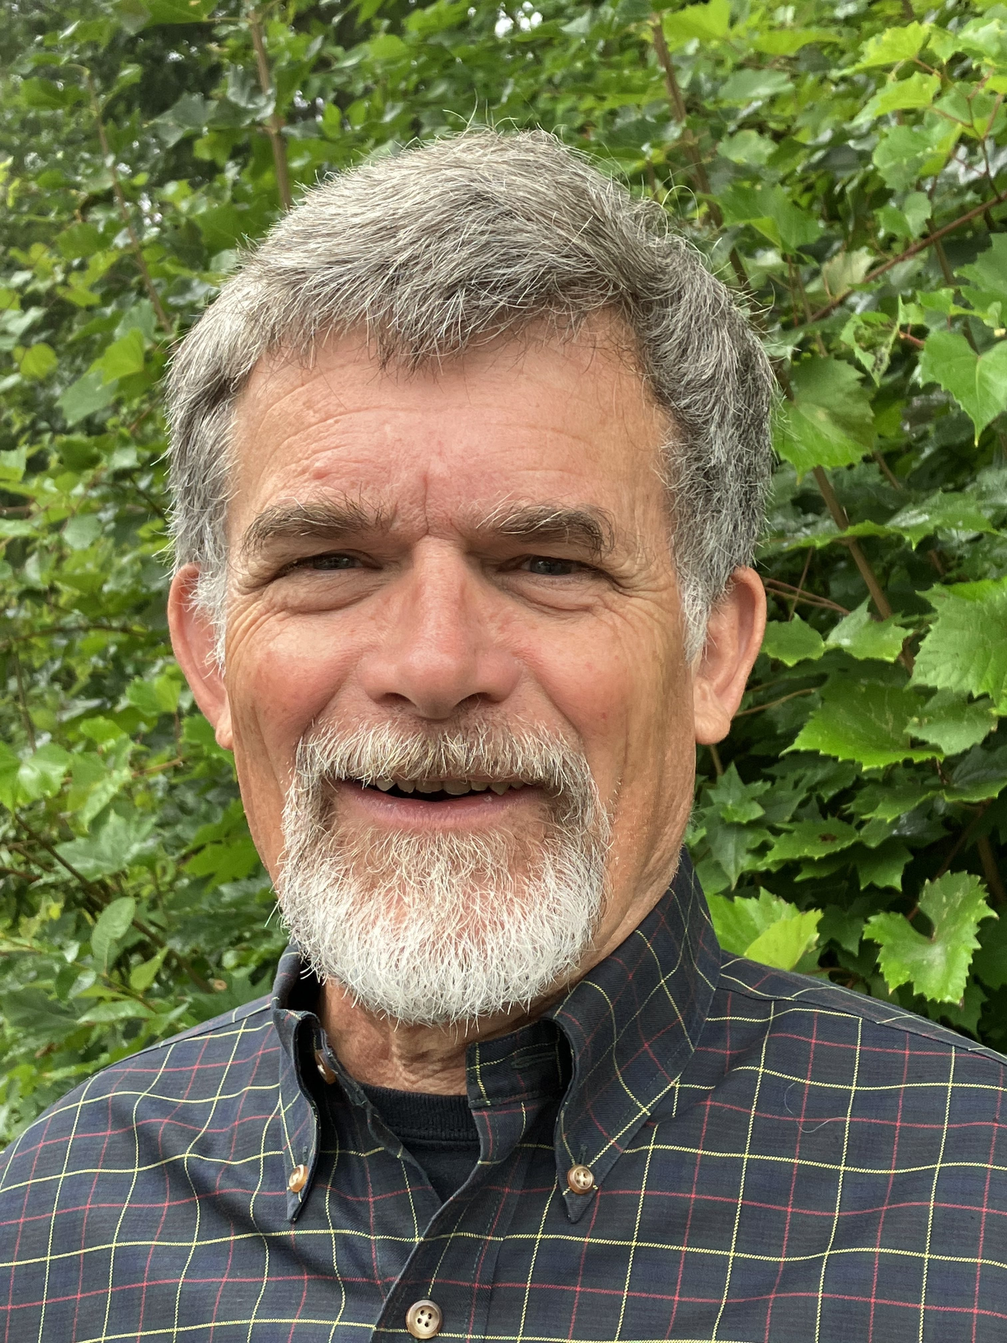
Marv Klassen-Landis, MA
Founding creative writer of Dartmouth Health’s Arts and Humanities Program 2009-2022
Poet, storyteller, arts consultant
mklassenlandis@gmail.com
Notes:
The Creative Writing Program at Dartmouth-Hitchcock Medical Center
In November of 2009 Marv Klassen-Landis began work as the first paid Creative Writing Specialist for Norris Cotton Cancer Center’s Patient and Family Support Service and D-H Arts.
Marv Klassen-Landis tells stories, performs poetry and leads written and spoken word residencies and workshops, and offers one-to-one writing coaching. Marv leads creative writing workshops with patients and supporters at the Norris Cotton Cancer Center, Dartmouth-Hitchcock Medical Center, the Children’s Hospital of Dartmouth and the Jack Byrne Center for Palliative and Hospice Care. He also does one-to-one writing coaching with patients and supporters and leads writing groups for oncology patients and supporters and for psychiatric patients. He has been participating in a study of creative writing with patients with advanced cancer and with seizure patients. Marv is a frequent storyteller and literacy presenter for the Children’s Literacy Foundation. A co-founder and performer with Children’s Voices Theatre, he has taught creative writing at the elementary, high school and college levels and has led many storytelling, writing and theatre workshops and residencies from Vermont to Colorado. As a poet, an artist-in-residence, and performer, Marv’s major emphasis in residencies and educator professional development workshops is inspiring reluctant readers and writers. Marv has developed integrated arts programs for children with disabilities and chronic illnesses. He also served as arts education director at a Vermont regional arts organization, working closely with school districts on standards based theatre and dance curriculum development, residencies, and performances for students. Marv has published poetry in a variety of journals and is the author/illustrator of a children’s book.

Slide 3
Summary
Finding Our Way in Grief combined Deadra’s traditional bereavement support group interventions with activities Marv uses with groups and individuals. Together, we crafted a curriculum that provided time and space for participants to fully enter into their grief, maintain a sense of connection with the loved one they lost and share the journey with others who were experiencing the same thing in a safe space.
Deadra and Marv offered five virtual sessions in 2020/2021. Each session consisted of six weekly group meetings that were 75 minutes in length. Each group had between six and twelve participants.

Slide 4
Key Ingredients
Creating and holding sacred space through openings, closings, mindful breathing
Silence and ritual as well as speaking and listening
Mix of modalities: ritual, metaphor, listening to poetry, writing, storytelling, sharing photographs and meaningful objects, personal sharing, responding to others
Structured interactions that ensure everyone gets equal time
Sequencing that optimizes a healthy emotional flow and growing trust and openness
Emphasis on personal choices—participants always have the choice to speak or pass

Slide 5
Benefits of Writing, Literature and Storytelling
Safe container/channel
Creative self-expression
Metaphor
“Third Thing”
Reframing
Reconstruction of meaning
Reintegration
Decreased anxiety
Gratitude

Slide 6
Sequence of Meetings
Meeting One – Introductions
Brief spoken introduction of yourself and your loved one
Introduction of the elements of grief via writing prompt:
“You will lose someone you can’t live without and your heart will be broken, and the bad news is that you will never completely get over the loss of your beloved. But this is also the good news. They live forever in your broken heart that doesn’t seal back up. And you come through.”
—Anne Lamott
Meeting Two – Honoring our loved ones with objects and stories
Share a favorite photograph and/or a beloved object
Share the qualities you treasure in your loved one
Meeting Three – Metaphors for grief
Explore the pain of loss through poetry and metaphor

Slide 7
Sequence of Meetings (continued)
Meeting Four – Letters
Write a letter to your loved one
Write a letter that you imagine your loved one writes to you
Session Five – Celebration of Memories
Tell stories about your loved one
Suggested themes: Adventures, laughter, food, surprises
Session Six – Group Closure and Blessings
What have you gained from being part of this group?
What do you hope to carry forward?
Write blessings for each other

Slide 8
Bibliography: Books
Charon, Rita, 2006. Narrative Medicine: Honoring the Stories of Illness. Cary, North Carolina: Oxford University Press.
Hedtke, Lorraine, 2012. Bereavement Support Groups: Breathing Life into Stories of the Dead. Chagrin Falls, Ohio: Taos Institute Publications.
Jeffers, Steven L. and Harold Ivan Smith, 2010. Finding a Sacred Oasis in Grief: A Resource Manual for Pastoral Care Givers. Louisville: Westminster John Knox Press.
Klass, Dennis, Robert A. Neimeyer, Edith Maria Steffen, Darcy L. Harris (eds.), 2017. Continuing Bonds in Bereavement: New Directions for Research and Practice. New York: Routledge.
Mitchell, Kenneth R. and Herbert Anderson, 1983. All Our Losses, All Our Griefs: Resources for Pastoral Care. Louisville: Westminster John Knox Press.
O’Donahue, John, 2008. To Bless the Space Between Us: A Book of Blessings. New York: Doubleday Press.
Palmer, Parker J., 2004. A Hidden Wholeness: The Journey Toward an Undivided Life. San Francisco: Jossey Bass.
Weller, Francis, (foreword by Michael Lerner), 2015. The Wild Edge of Sorrow: Rituals of Renewal and the Sacred Work of Grief. Berkeley: Doubleday Press.
Wolfelt, Alan D., 2004. The Understanding Your Grief Support Group Guide: Starting and Leading a Bereavement Support Group. Chicago, Companion Press.

Slide 9
Bibliography: Articles
Bolton G. "Writing is a way of saying things I can't say"--therapeutic creative writing: a qualitative study of its value to people with cancer cared for in cancer and palliative healthcare. Med Humanit. 2008 Jun;34(1):40-6. doi: 10.1136/jmh.2007.000255. PMID: 23674539.
Collins A. "It's very humbling": The Effect Experienced by Those Who Facilitate a Legacy Project Session Within Palliative Care. Am J Hosp Palliat Care. 2019 Jan;36(1):65-71. doi: 10.1177/1049909118787772. Epub 2018 Jul 15. PMID: 30009616.
Crogan NL, Evans BC, Bendel R. Storytelling intervention for patients with cancer: part 2--pilot testing. Oncol Nurs Forum. 2008 Mar;35(2):265-72. doi: 10.1188/08.ONF.265-272. PMID: 18321839.
Evans BC, Crogan NL, Bendel R. Storytelling intervention for patients with cancer: part 1--development and implementation. Oncol Nurs Forum. 2008 Mar;35(2):257-64. doi: 10.1188/08.ONF.257-264. PMID: 18321838.
Furnes B, Dysvik E. A systematic writing program as a tool in the grief process: part 1. Patient Prefer Adherence. 2010 Dec 6;4:425-31. doi: 10.2147/PPA.S14864. PMID: 21206518; PMCID: PMC3003609. https://pubmed.ncbi.nlm.nih.gov/21311698/
Ihrmark C, Hansen EM, Eklund J, Stödberg R. "You are weeping for that which has been your delight": to experience and recover from grief. Omega (Westport). 2011-2012;64(3):223-39. doi: 10.2190/om.64.3.c. PMID: 22455107.
Memarian N, Torre JB, Haltom KE, Stanton AL, Lieberman MD. Neural activity during affect labeling predicts expressive writing effects on well-being: GLM and SVM approaches. Soc Cogn Affect Neurosci. 2017 Sep 1;12(9):1437-1447. doi: 10.1093/scan/nsx084. PMID: 28992270; PMCID: PMC5629828. https://www.ncbi.nlm.nih.gov/pmc/articles/PMC5629828
Palma A, Rojas V, Ihl F, Ávila C, Plaza-Parrochia F, Estuardo N, Castillo D. Implementation of a Palliative Hospital-Centered Spiritual and Psychological Telehealth System During COVID-19 Pandemic. J Pain Symptom Manage. 2021 Nov;62(5):1015-1019. doi: 10.1016/j.jpainsymman.2021.04.016. Epub 2021 May 3. PMID: 33957254; PMCID: PMC8091732.

Slide 10
Bibliography: Articles (continued)
Romanoff BD, Thompson BE. Meaning construction in palliative care: the use of narrative, ritual, and the expressive arts. Am J Hosp Palliat Care. 2006 Aug-Sep;23(4):309-16. doi: 10.1177/1049909106290246. PMID: 17060295.
Southall DJ. Creating new worlds: the importance of narrative in palliative care. J Palliat Care. 2011 Winter;27(4):310-4. PMID: 22372286.
Steiner CS. Grief support groups used by few--are bereavement needs being met? J Soc Work End Life Palliat Care. 2006;2(1):29-53. doi: 10.1300/J457v02n01_04. PMID: 17387081.
Vergo MT, Klassen-Landis M, Li Z, Jiang M, Arnold RM. Getting Creative: Pilot Study of a Coached Writing Intervention in Patients with Advanced Cancer at a Rural Academic Medical Center. J Palliat Med. 2022 Mar;25(3):472-478. doi: 10.1089/jpm.2021.0335. Epub 2021 Dec 23. PMID: 34941445.
Weaver MS, Jurgens A, Neumann ML, Schalley SM, Kellas JK, Navaneethan H, Tullis J. Actual Solidarity through Virtual Support: A Pilot Descriptive Study of an Online Support Group for Bereaved Parents. J Palliat Med. 2021 Aug;24(8):1161-1166. doi: 10.1089/jpm.2020.0617. Epub 2021 Jan 6. PMID: 33404324.
Young E. Figures of grief: metaphors from a bereavement writing group. Omega (Westport). 2007-2008;56(4):359-67. doi: 10.2190/om.56.4.d. PMID: 18435327.

